Slide 1
Renewable Automation
Manuel Eiweck 188.461 Multimedia Interfaces
Research Unit of Computer Graphics
Institute of Visual Computing & Human-Centered Technology
TU Wien, Austria

Slide 2
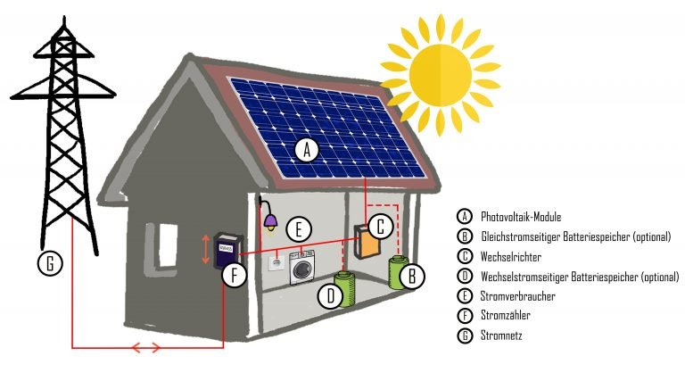

Project Idea
House Automation for Renewable Energy Sources
Optimize the usage of variable energy consumers
Reduce the total amount of energy we deliver/pull from the grid.
=> reduces cost as usually it is not billed 1:1
© Bundesverband PHOTOVOLTAIC AUSTRIA

Slide 3
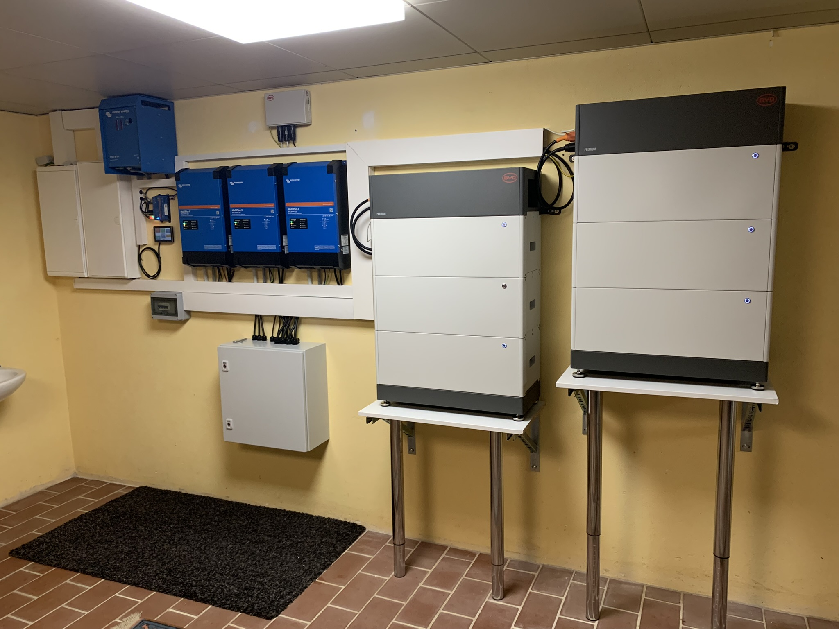
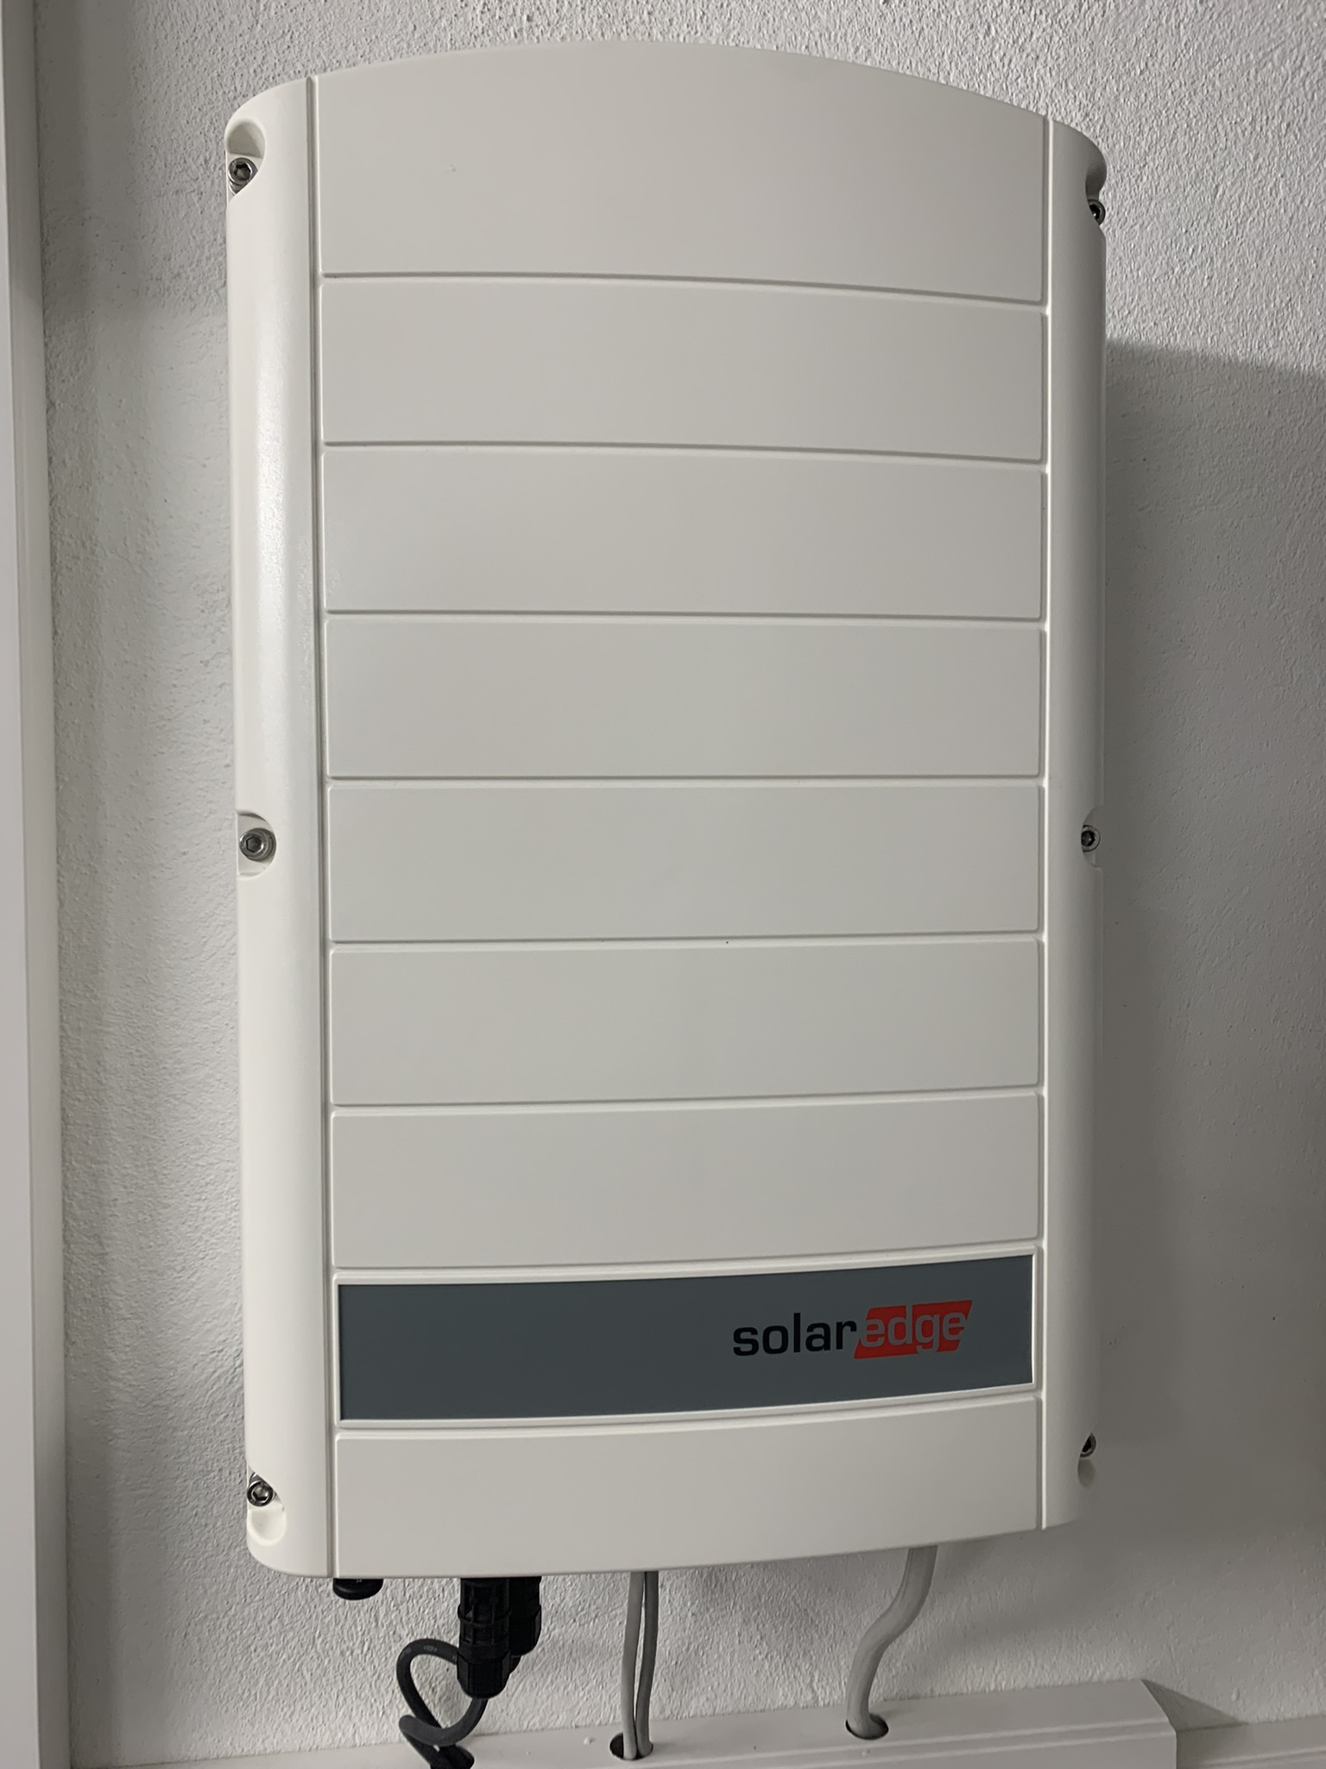
Hardware

Slide 4
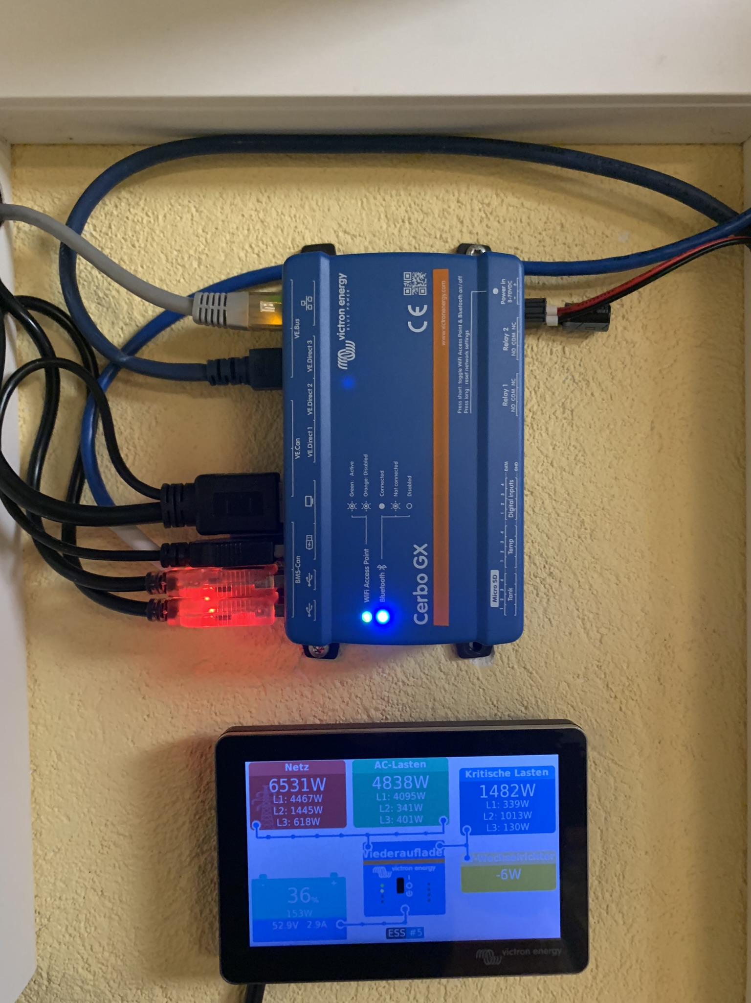
Plan
Get some data how much power is produced, used …
Use this information to decide if we want to enable or disable a variable power consumer
Use the Arduino to switch a 220V relay

Slide 5
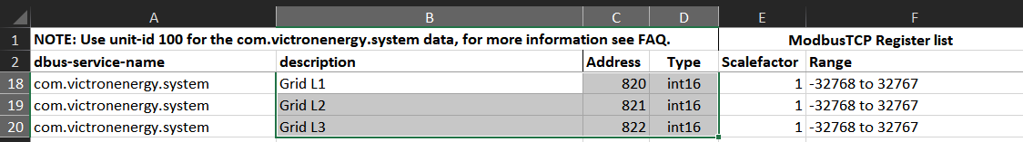
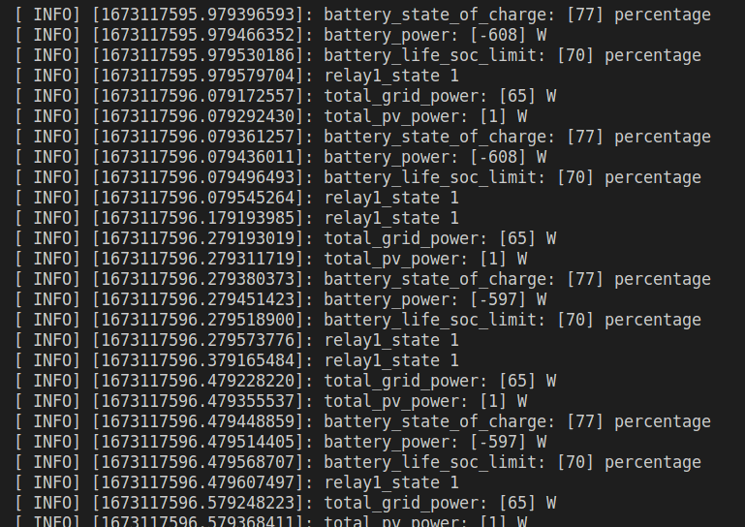
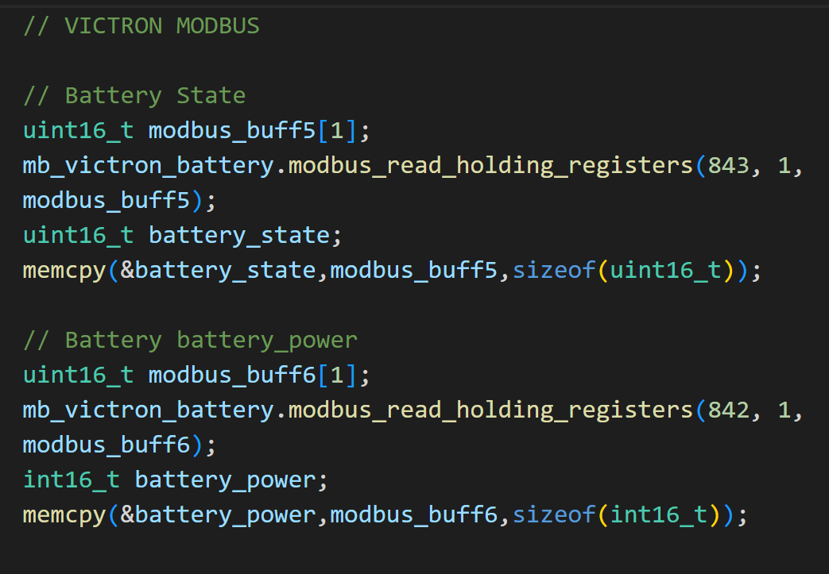
Data
Modbus over TCP/IP
Manufacturer of the Inverter open sourced a lot of their interfaces

Slide 6
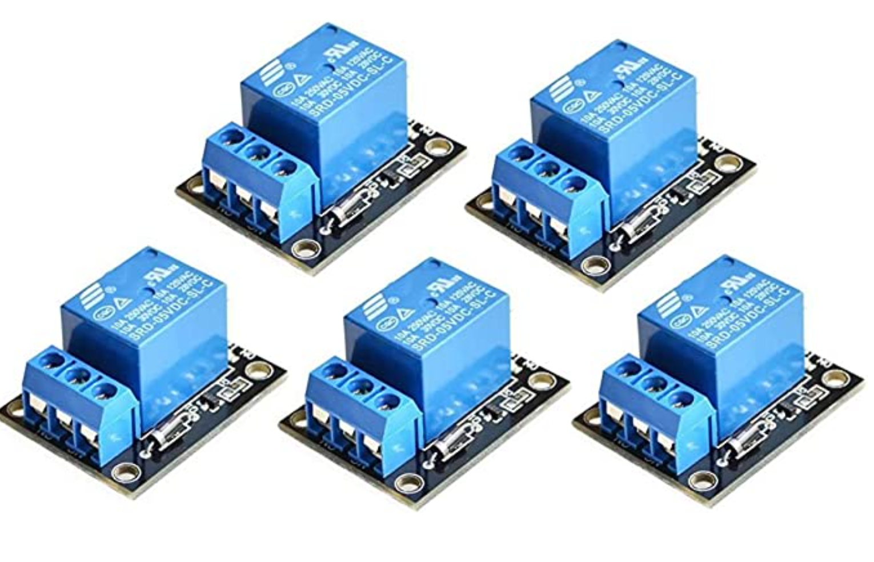
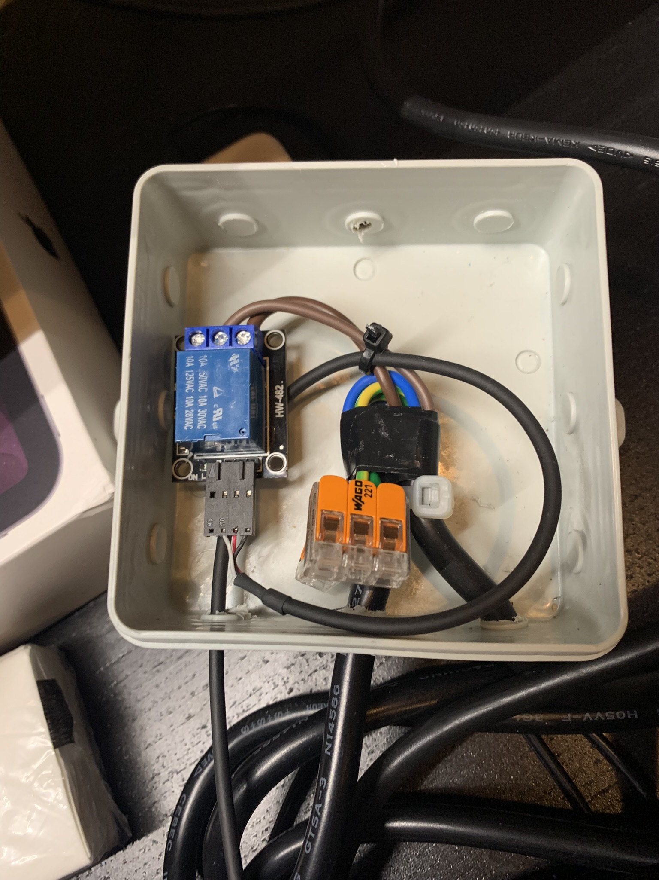
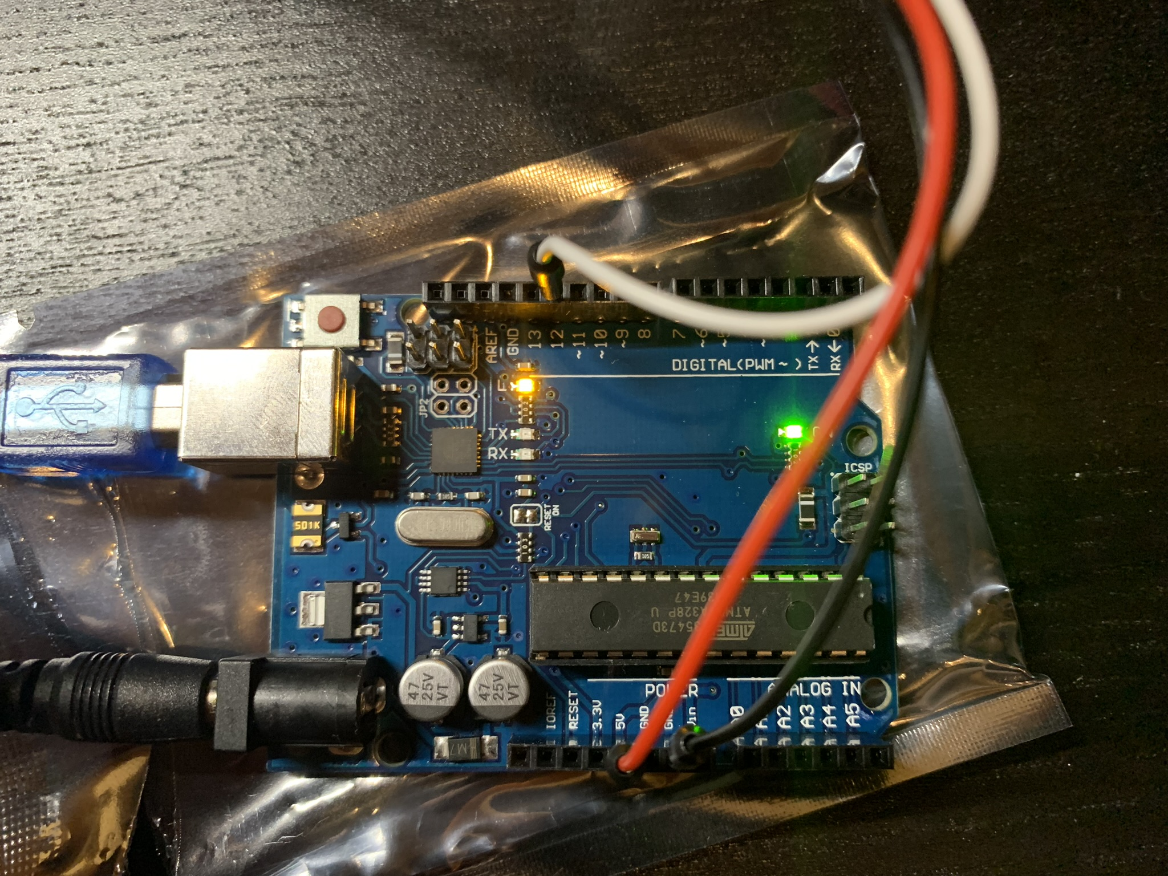
Arduino

Slide 7
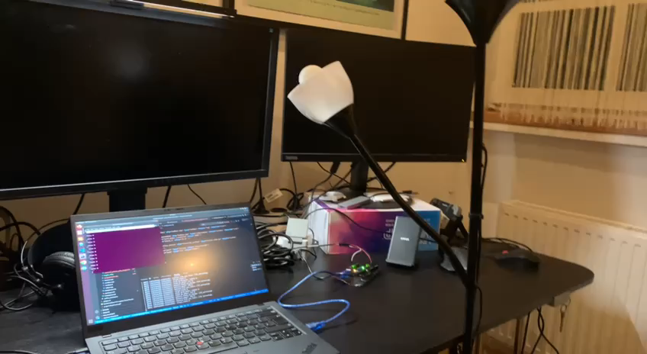

Slide 8
Ros Setup
Ros Topics grid power
PV power …
Victron Inverter Setup
Ros node
Modbus Consumer
Ros node
Compute
Modbus
Draws Power
Ros Topics replay1 state
Energy Consumer
Serial
Arduino Microcontroller
Serial
Ros node Arduino
Controller

Slide 9
Thank You for your Attention!

